Slide 1
Subscribe to DeepL Pro to edit this document.
Visit www.DeepL.com/pro for more information.

Slide 2
Open data
Intelligent Infrastructure Design for the Internet of Things
Antonio Navarro

Slide 3
Index
References
Introduction
Initiatives
Open data formats
Access to open data
Conclusions

Slide 4
References
(Hand, 2012) Hand, D. Open data is a force for good, but not without risks. The Guardian. https://www.theguardian.com/society/2012/jul/10/open-data-force-for-good-risks
(Newcombe, 2015) Newcombe, T. The (Hidden) Cost of Open Data. Governing. http://www.governing.com/columns/tech-talk/gov-open-data-cost-problems.html
(Roberts, 2012) Robert, T. The Problem with Open Data. Computer Weekly. http://www.computerweekly.com/opinion/The-problem-with-Open-Data

Slide 5
Introduction
Open data initiatives seek to make public as much data as possible that can be useful to people.
The information is published as datasets.
Why do it?
Transparency
Providing social and commercial value
Participation and commitment
The initiatives themselves consider that not all data can be public:

Slide 6
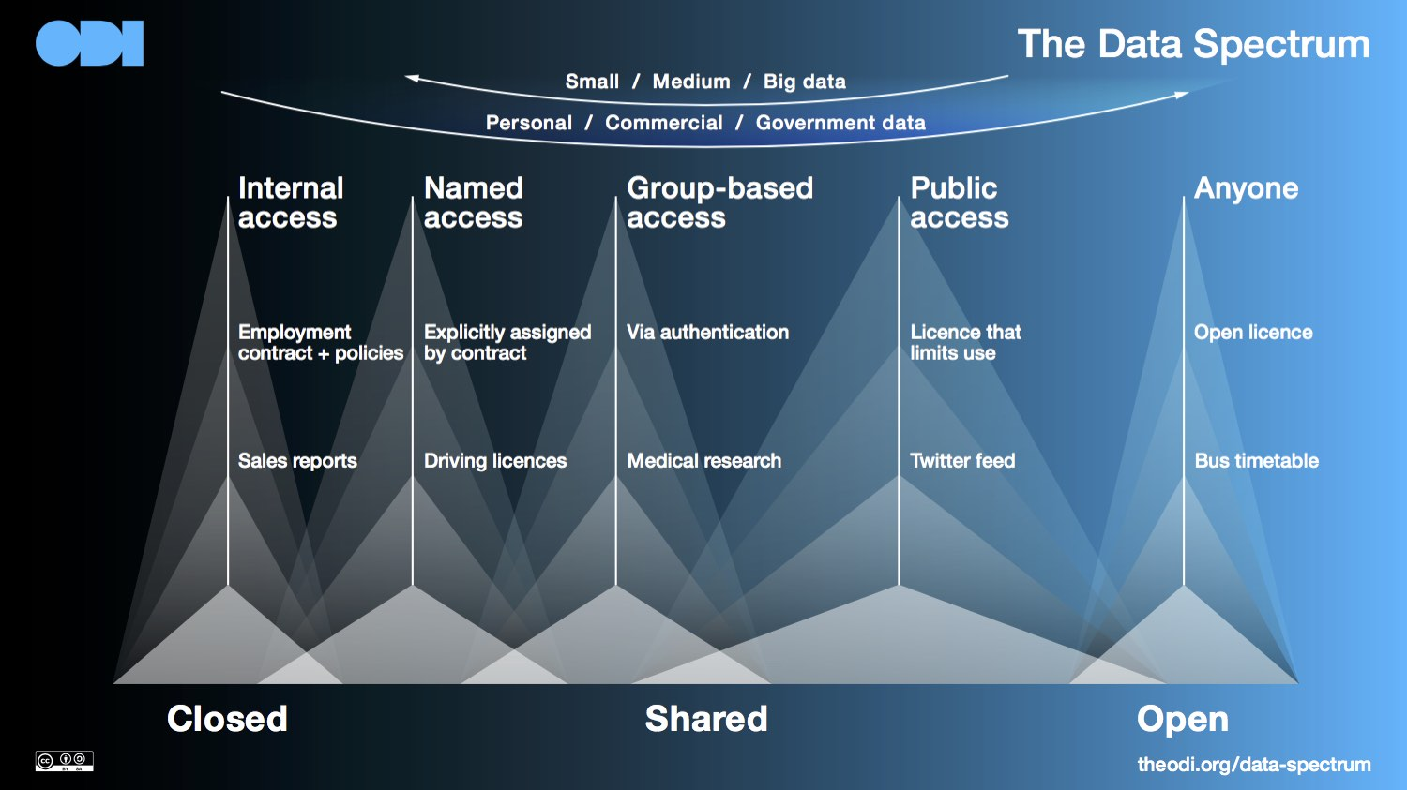
Introduction
Range of data according to the Open Data Institute

Slide 7
Initiatives
There are basically two types of initiatives:
Those that promote open data:
Open Data for Development: http://od4d.net/
Open Data Institute (ODI): https://theodi.org/
Open Data Incubator Europe (ODINE): https://opendataincubator.eu/
Open Knowledge International: https://okfn.org/
The Opportunity Project: https://opportunity.census.gov/
Those that provide open data (in a way, these could be considered subtypes of the former):
Government of Spain: http://datos.gob.es/
US Government: https://www.data.gov/
GB Government: https://data.gov.uk/
Government of Russia: http://data.gov.ru/

Slide 8
Initiatives
Government of Japan: http://www.data.go.jp/
Autonomous Community of the Basque Country: http://opendata.euskadi.eus/
Generalitat de Catalunya: http://dadesobertes.gencat.cat
Madrid City Council: http://datos.madrid.es
Tiétar Town Hall: http://www.tietar.es/open-data
Governments that do not have open data initiatives:
China: https://opendatachina.com/ (did not have in 2017).
North Korea
Cuba
Israel: https://data.gov.il/ (did not have in 2017).
Turkey
Venezuela
We have a list at: https://www.data.gov/open-gov/

Slide 9
Initiatives
What can we find in the Spanish Government's open data portal?
Let's take a look: http://datos.gob.es
The scorecard is worth a look: https://datos.gob.es/es/dashboard
The portal allows three different accesses:
Navigating through the portal itself
Through a REST API
Through a SPARQL point

Slide 10
Initiatives
Are such initiatives worthwhile?
It seems to be so, at least that's what the promoters say.
https://www.england.nhs.uk/ourwork/tsd/data-info/open-data/examples/
https://theodi.org/projects-services/projects/
However, they have obvious problems (Hand, 2012; Robers, 2012):
Raw data can only be understood by a technical elite. This may cause more inequalities than benefits
To what extent are they honest initiatives or a matter of politicians' public relations?
Negative data (erroneous or not) can stigmatize groups/areas.
High collection costs

Slide 11
Initiatives
The Government of Spain's own open data portal identifies five problems:
Licenses not open or unclear, which makes their use difficult
Incomplete data sets
Non-machine-readable or difficult to reuse formats
Outdated data
Access fees
There is a major problem: the structure of the data, beyond the format.

Slide 12
Open data formats
Open Knowledge International defines three key rules for making data open:
Keep it simple
Involve early and involve often.
Addressing common fears and misunderstandings
It also identifies four key steps
Choosing data sets
Apply an open license
Making data available
Make them easy to find

Slide 13
Open data formats
A key step is the publication of open data in a format easily processed by computers:
XML (eXtensible Markup Language)
< menu id="file" value="File">
< popup>
< menuitem value="New" onclick="CreateNewDoc()" />
< menuitem value="Open" onclick="OpenDoc()" />
< menuitem value="Close" onclick="CloseDoc()" />
</popup>
</menu>

Slide 14
Open data formats
JSON (JavaScript Object Notation)
{ "menu": {
"id": "file",
"value": "File",
"popup": {
"menuitem": [
{ "value": "New", "onclick": "CreateNewDoc()"},
{ "value": "Open", "onclick": "OpenDoc()"},
{ "value": "Close", "onclick": "CloseDoc()"}
]
}
}}

Slide 15
Open data formats
RDF (Resource Description Framework)
<? xml version="1.0" encoding="UTF-8"?>
< rdf:RDF
xmlns:rdf="http://www.w3.org/1999/02/22-rdf-syntax-ns#"
xmlns:dc="http://purl.org/dc/elements/1.1/"
xmlns:region="http://www.country-regions.fake/">
< rdf:Description rdf:about="http://en.wikipedia.org/wiki/Oxford">
< dc:title>Oxford</dc:title>
< dc:coverage>Oxfordshire</dc:coverage>.
< dc:publisher>Wikipedia</dc:publisher>
<region:population>10000</region:population>
< region:principaltown rdf:resource="http://www.country-regions.fake/oxford"/>
</rdf:Description>
</rdf:RDF>

Slide 16
Open data formats
Comma-Separated Values (CSV )
Spreadsheet formats
ESRI Shapefile (SHP): geographic information data
Keyhole Markup Language (KML): geographic information data
PC-AXIS: statistical data
PDF
Text
Scanned images

Slide 17
Access to open data
Data is usually accessible in three different ways:
Navigating directly on the web
By means of web services, usually REST (Representational State Transfer).
POST: Create
GET: Read (e.g. http://datos.gob.es/apidata/nti/territory/Province/Madrid )
PUT: Update
DELETE: Delete
SPARQL (SPARQL Protocol and RDF Query Language)
It is a language for querying databases containing RDF data.
The DBPedia, for example, also has a SPARQL point: http://dbpedia.org/sparql.

Slide 18
Access to open data
We can execute the following SPARQL query:
PREFIX dcterms: <http://purl.org/dc/terms/>
PREFIX rdfs: <http://www.w3.org/2000/01/rdf-schema#>
PREFIX dbp: <http://dbpedia.org/ontology/>
SELECT ? musician ? musicianName ? dateBirth ? dateDeceased
WHERE {
? musico dcterms:subject
<http://dbpedia.org/resource/Category:Spanish_musicians>;
rdfs:label ? nameMusician ;
dbp:birthDate ? dateBirth ;
dbp:deathDate ? deathDate .
FILTER (LANG(? musicName) = "en")
}

Slide 19
Conclusions
Open data seems like a good idea
However, it is necessary to distinguish useful data from mere political posturing.
From an IT point of view, they do not represent a technical challenge, beyond choosing a suitable structure and format.
Probably, the REST access mechanism is the most reasonable one.

